Slide 1

Connecting proteins to genes programmatically with UniProt
Part of the series on: EMBL-EBI, programmatically: take a REST from manual searches
Andrew Nightingale
help@uniprot.org

Slide 2
Contents
Part I: Introduction/Refresher
What is the UniProt Proteins API?
Where to find it?
Part II: Using the Proteins API services for complex questions
From protein features to genomic coordinates
Putting it all together with scripts

Slide 3
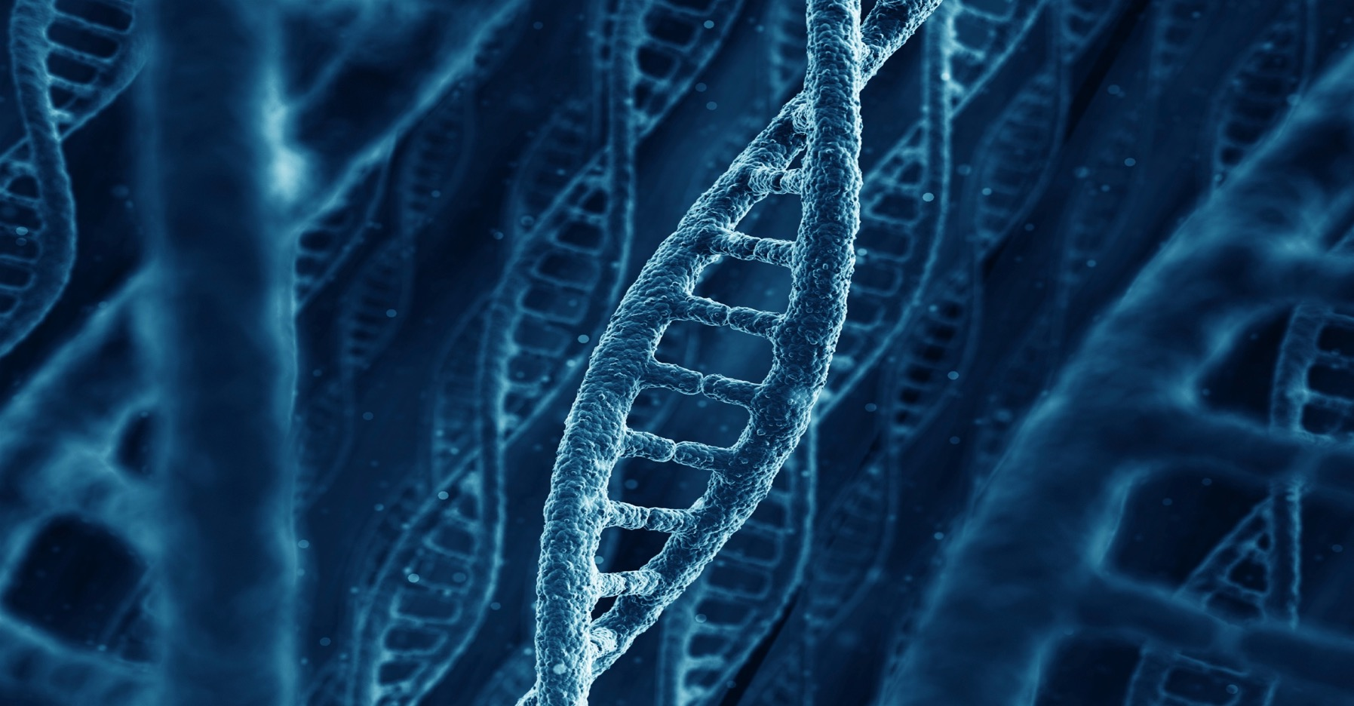
Part I What is the Proteins API? and Where to find it.

Slide 4
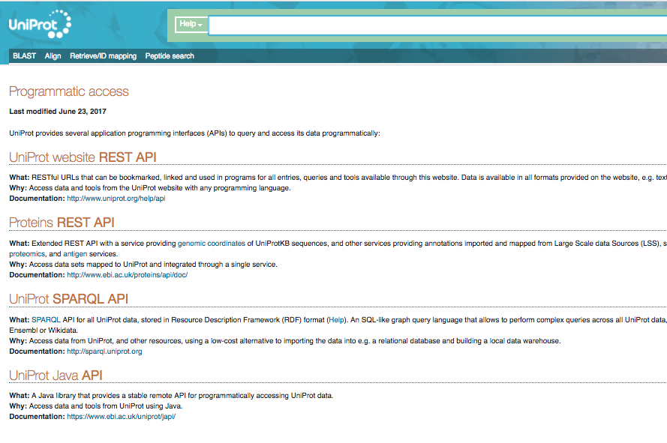
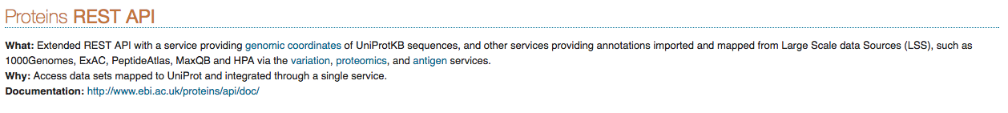
Finding the proteins API

Slide 5
https://www.ebi.ac.uk/proteins/api/doc/

Slide 6
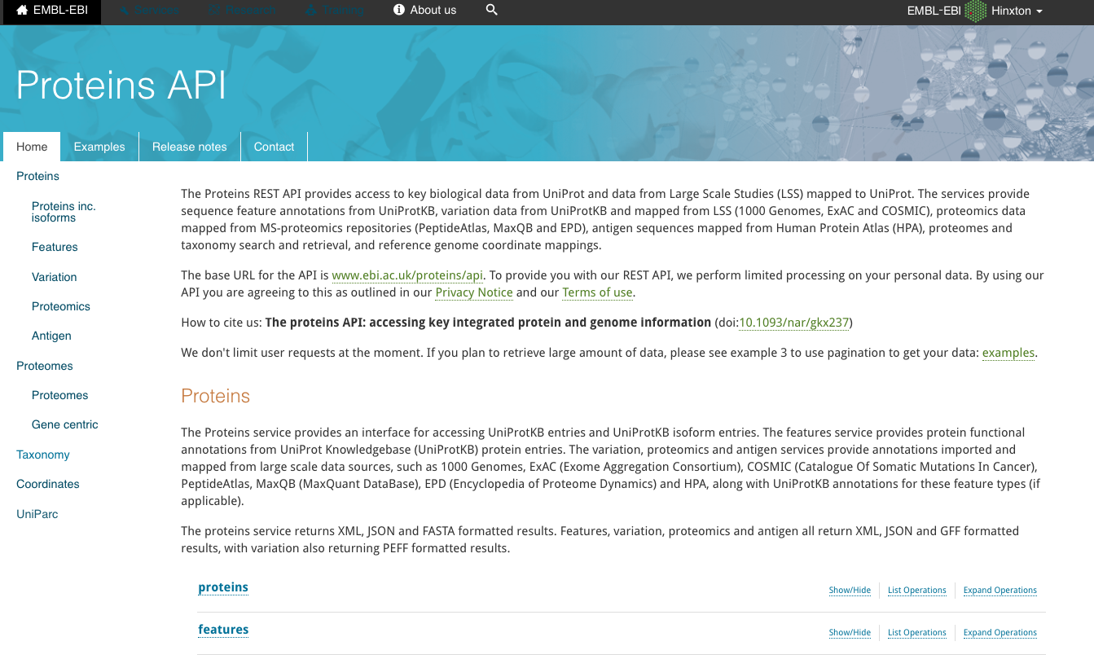
The Proteins API web interface

Slide 7
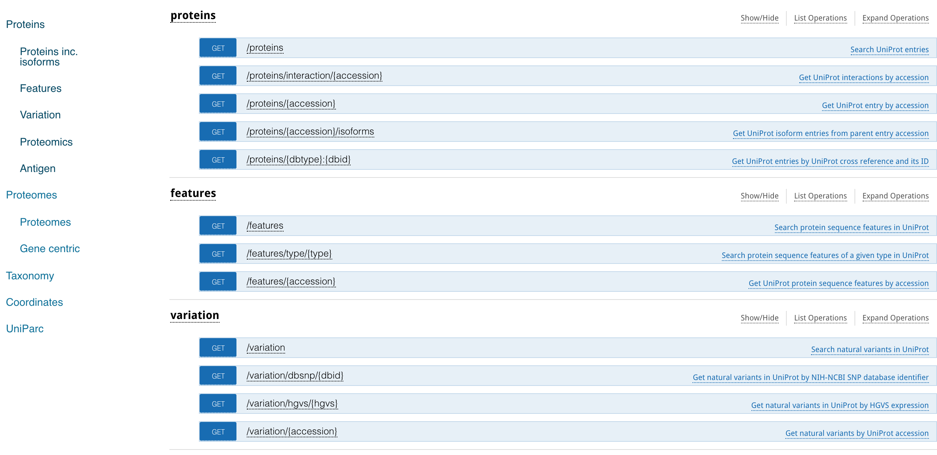

Slide 8
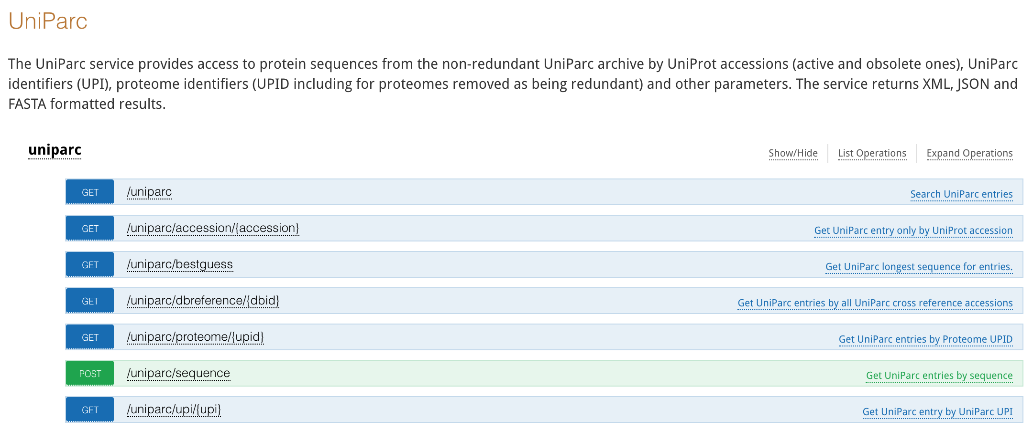

Slide 9
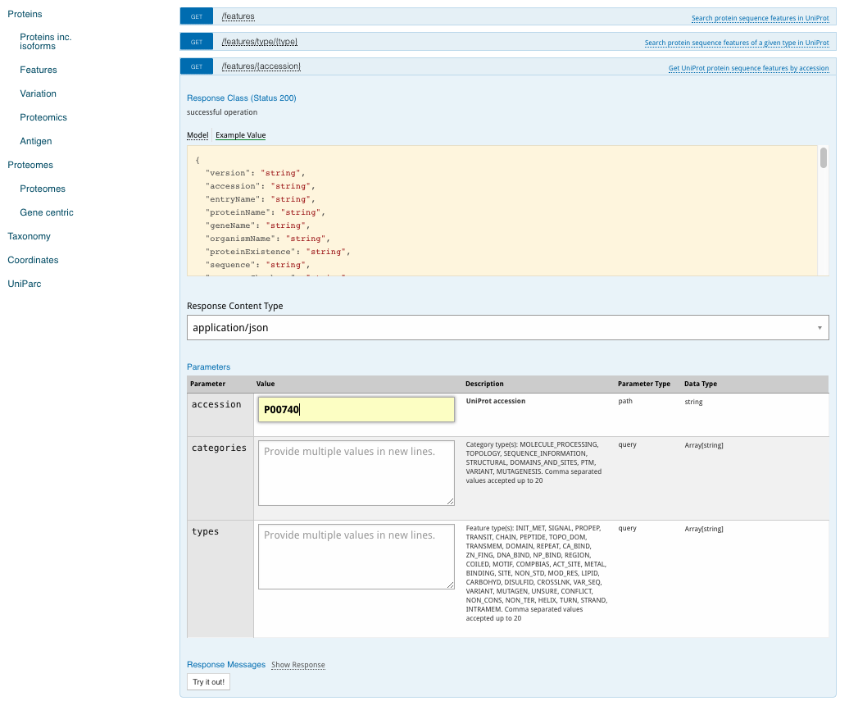
Swagger
Example output and data model (based upon selected response type).
Selection of response type. JSON and XML default options
User interface to add get request search options
Click ‘Try it out’ to execute

Slide 10
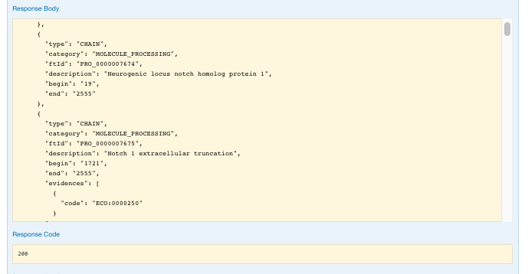
Example output
Feature annotation
layout, with type, Id, location and evidence.
A 200 code
means success

Slide 11
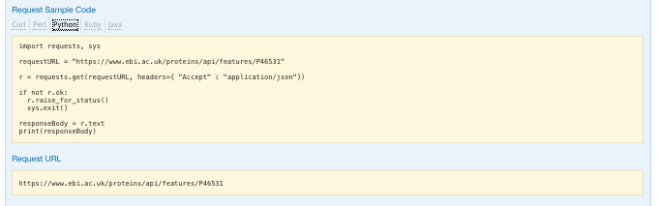
Basic script
Five sample code options provided.
Simple python script example.
You can simply use the URL in your browser.

Slide 12
Part II Using the Proteins API services for complex questions.

Slide 13
Proteins API Coordinates Service
Scenario:
Want to know how many exons compose the UniProt entry of FGFR2 gene (P21802).
And the exact mapping of exon genomic coordinates to the equivalent section of protein sequence
Want to be able to do this using a scripting language

Slide 14
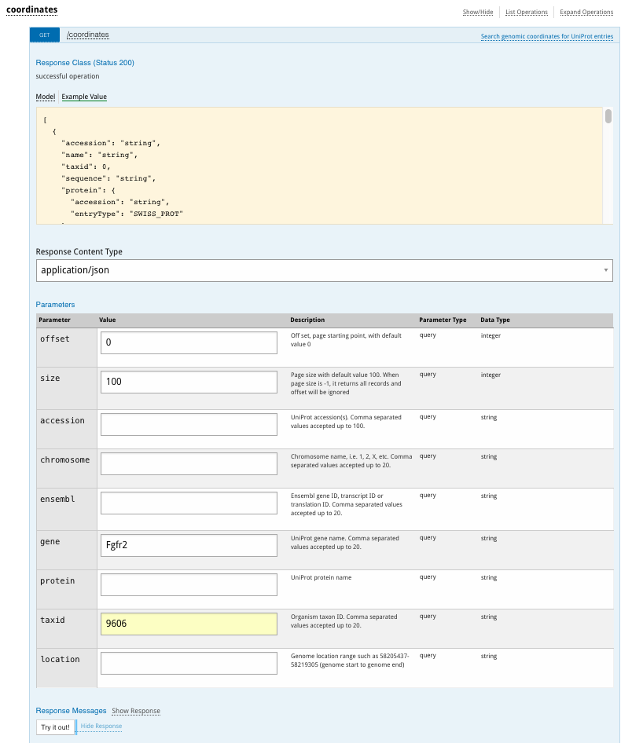
Proteins API Coordinates Service
Protein to genomic mappings for FGFR2 gene
Searching for human only mappings using taxonomy id 9606

Slide 15
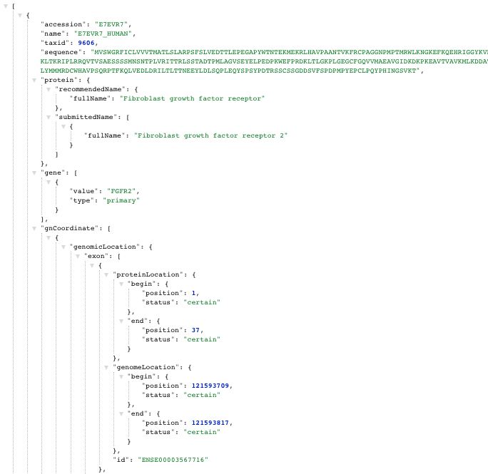
Proteins API Coordinates Service
Example JSON response
Protein sequence range within exon
Genomic coordinates of exon
Ensembl exon id

Slide 16
Coordinates by Python Scripting
Illustrate the separate steps to get the same response and process the data using a Python script
Making a get request
Extract specific data elements from the JSON response

Slide 17
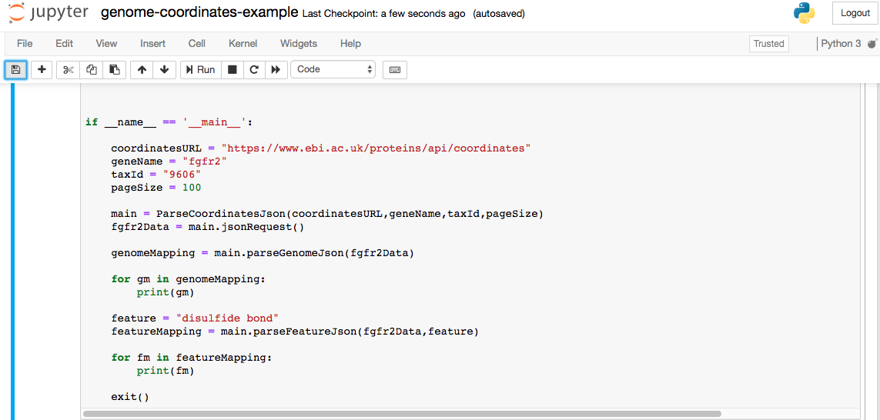
Coordinates by Python Scripting
Main Script parameters
Execute the Get request with parameters
Process results to get exon mapping
Now repeat processing to get disulfide bond genome coordinates

Slide 18
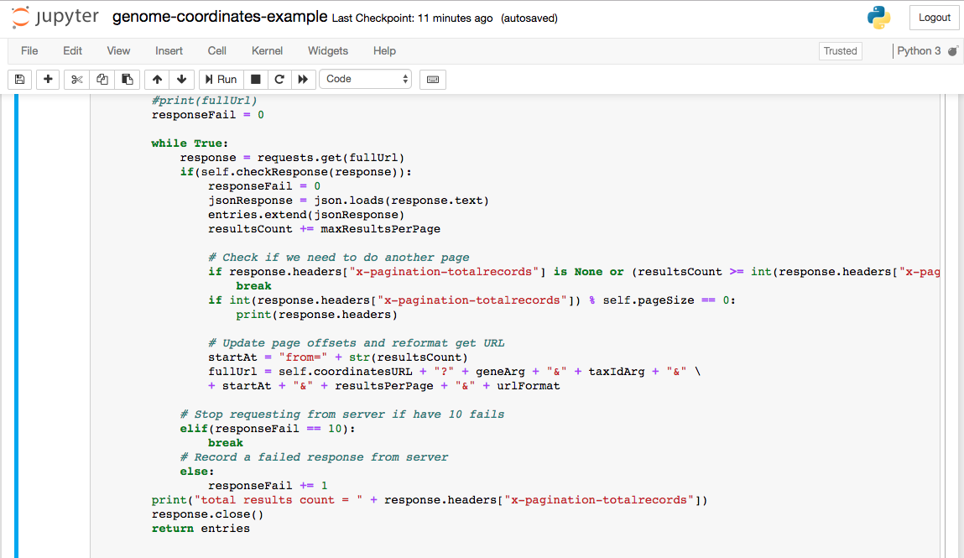
Coordinates by Python Scripting
Execute request
Check response code
Convert text to JSON and add to data
Check pagination and reformat request URL
Close request and return data in JSON format

Slide 19
Coordinates by Python Scripting
Process results to get exon mapping

Slide 20
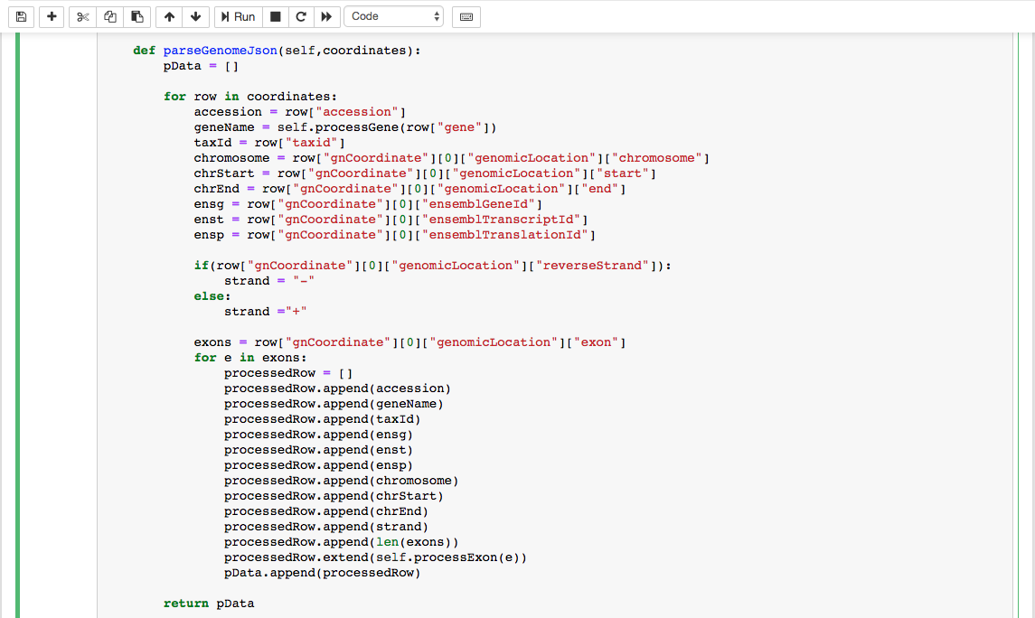
Coordinates by Python Scripting
Loop though every row in JSON data
Simple model makes it easy to parse specific data values
Multiple levels in the data model can be navigated to get specific data values
Data model provides all the data required to make a complete mapping, including the exons that make up the transcript.

Slide 21
Coordinates by Python Scripting Output
Exon Mapping results
['P21802', 'FGFR2', 9606, 'ENSG00000066468', 'ENST00000358487', 'ENSP00000351276', '10', 121479860, 121593817, '-', 17, 'ENSE00003567716', 121593709, 121593817, 1, 37]
['P21802', 'FGFR2', 9606, 'ENSG00000066468', 'ENST00000358487', 'ENSP00000351276', '10', 121479860, 121593817, '-', 17, 'ENSE00003488412', 121565438, 121565704, 37, 126]
['P21802', 'FGFR2', 9606, 'ENSG00000066468', 'ENST00000358487', 'ENSP00000351276', '10', 121479860, 121593817, '-', 17, 'ENSE00003637083', 121564502, 121564579, 126, 152]
Feature annotation mapping results
['P21802', 'FGFR2', 9606, 'ENSG00000066468', 'ENST00000358487', 'ENSP00000351276', '10', 121479860, 121593817, '-', 'disulfide bond', 'feature #1', 121538647, 121551379, 179, 231, ['PROSITE-ProRule PRU00114 ECO:0000255', 'PubMed 16384934 ECO:0000269’]]
['P21802', 'FGFR2', 9606, 'ENSG00000066468', 'ENST00000358487', 'ENSP00000351276', '10', 121479860, 121593817, '-', 'disulfide bond', 'feature #2', 121565493, 121565630, 62, 107, ['PROSITE-ProRule PRU00114 ECO:0000255’]]
['P21802', 'FGFR2', 9606, 'ENSG00000066468', 'ENST00000358487', 'ENSP00000351276', '10', 121479860, 121593817, '-', 'disulfide bond', 'feature #3', 121517377, 121520086, 278, 342, ['PROSITE-ProRule PRU00114 ECO:0000255', 'PubMed 16384934 ECO:0000269']]

Slide 22
Thank You
And
Any Question

Slide 23
Coordinates by Python Scripting
def processExon(self,exon):
exonDat = []
exonDat.append(exon["id"])
exonDat.append(exon["genomeLocation"]["begin"]["position"])
exonDat.append(exon["genomeLocation"]["end"]["position"])
exonDat.append(exon["proteinLocation"]["begin"]["position"])
exonDat.append(exon["proteinLocation"]["end"]["position"])
return exonDat
The exon data type consists of 3 main elements. genomeLocation and proteinLocation define the respective beginning and end positions in the genome (chromosome specific) and protein sequences

Slide 24
Feature Coordinates by Python Scripting
Features in the same section of the data model as genomeLocation
features = row["gnCoordinate"][0]["feature"]
fcnt = 1
for f in features:
# Only want to get the specified featureType (annotation Type)
if(f["type"] != featureType):
continue
processedRow.extend(self.processFeature(f))
Only process the feature type we want
Similar data model architecture using slightly different controlled vocabulary
def processFeature(self,feat):
featDat = []
featDat.append(feat["genomeLocation"]["begin"]["position"])
featDat.append(feat["genomeLocation"]["end"]["position"])
featDat.append(feat["location"]["begin"]["position"])
featDat.append(feat["location"]["end"]["position"])
evidence = feat["evidence"]
mergedEvid = []
for e in evidence:
if("dbReference" in e):
evidVal = e["dbReference"]["type"] + " " + e["dbReference"]["id"] + " " + e["code"]
else:
evidVal = e["code"]
mergedEvid.append(evidVal)
featDat.append(mergedEvid)
return featDat
Evidence for the feature annotation available

Slide 25
Genome Coordinates for multiple species
What if we want to know how genes differ across species?
The coordinates service can be used to select multiple genes from multiple species.
In this next example we will modify the script to look at the Notch1 gene over three species: Human (9606), Mouse (10090) and Zebrafish (7955)
The Swagger web interface will allow you to do exactly the same as we’re about to do in Python.

Slide 26
Coordinates by Python Scripting
Using a comma separated list of taxonomy identifiers
if __name__ == '__main__':
coordinatesURL = "https://www.ebi.ac.uk/proteins/api/coordinates"
geneName = "notch1"
taxId = "9606,10090,7955"
pageSize = 100
main = ParseCoordinatesJson(coordinatesURL,geneName,taxId,pageSize)
notch1Data = main.jsonRequest()
genomeMapping = main.parseGenomeJson(notch1Data)
https://www.ebi.ac.uk/proteins/api/coordinates?gene=notch1&taxid=9606,10090,7955
&offset=0&size=100format=json

Slide 27
Coordinates by Python Scripting
Additional for loop to handle multiple genes and transcripts
for row in coordinates:
accession = row["accession"]
geneName = self.processGene(row["gene"])
taxId = row["taxid"]
for trans in row["gnCoordinate"]:
chromosome = trans["genomicLocation"]["chromosome"]
chrStart = trans["genomicLocation"]["start"]
chrEnd = trans["genomicLocation"]["end"]
ensg = trans["ensemblGeneId"]
exons = trans["genomicLocation"]["exon"]
for e in exons:
processedRow = []
processedRow.append(accession)
processedRow.append(geneName)

Slide 28
Multiple Species Python Scripting Output
['P46531', 'NOTCH1', 9606, 'ENSG00000148400', 'ENST00000277541', 'ENSP00000277541', '9', 136496074, 136545786, '-', 34, 'ENSE00001247593', 136545726, 136545786, 1, 21]
['Q01705', 'Notch1', 10090, 'ENSMUSG00000026923', 'ENSMUST00000028288', 'ENSMUSP00000028288', '2', 26459534, 26503558, '-', 34, 'ENSMUSE00000842070', 26503498, 26503558, 1, 21]
['A2AIX5', 'Notch1', 10090, 'ENSMUSG00000026923', 'ENSMUST00000132820', 'ENSMUSP00000115258', '2', 26471278, 26509657, '-', 3, 'ENSMUSE00000758119', 26509612, 26509657, 1, 16]
['F1QCA7', 'notch1b', 7955, 'ENSDARG00000052094', 'ENSDART00000050855', 'ENSDARP00000050854', '5', 65000732, 65103529, '-', 34, 'ENSDARE00000691015', 65103472, 65103529, 1, 20]
['A0A0R4IMV9', 'notch1b', 7955, 'ENSDARG00000052094', 'ENSDART00000169616', 'ENSDARP00000137615', '5', 65000732, 65103529, '-', 34, 'ENSDARE00001174841', 65103472, 65103529, 1, 20]
['A5WUN6', 'notch1b', 7955, 'ENSDARG00000052094', 'ENSDART00000130888', 'ENSDARP00000105460', '5', 65000732, 65099081, '-', 33, 'ENSDARE00001105610', 65099076, 65099081, 1, 2]
['A0A0R4IT11', 'notch1a', 7955, 'ENSDARG00000103554', 'ENSDART00000160208', 'ENSDARP00000131914', '21', 4602562, 4684307, '-', 33, 'ENSDARE00001199233', 4684244, 4684307, 1, 22]
['A0A0R4IT11', 'notch1a', 7955, 'ENSDARG00000103554', 'ENSDART00000168930', 'ENSDARP00000137942', '21', 4602562, 4684307, '-', 33, 'ENSDARE00001209163', 4684244, 4684307, 1, 22]
['A0A0R4IT11', 'notch1a', 7955, 'ENSDARG00000103554', 'ENSDART00000177821', 'ENSDARP00000144572', '21', 4602562, 4684307, '-', 33, 'ENSDARE00001247709', 4684244, 4684307, 1, 22]
['I3IS74', 'notch1a', 7955, 'ENSDARG00000103554', 'ENSDART00000151019', 'ENSDARP00000125740', '21', 4684245, 4684307, '-', 1, 'ENSDARE00001071721', 4684245, 4684307, 1, 21]
['A0A0R4IW83', 'notch1a', 7955, 'ENSDARG00000103554', 'ENSDART00000158232', 'ENSDARP00000140612', '21', 4602562, 4629121, '-', 20, 'ENSDARE00001225782', 4629007, 4629121, 1, 39]

